Slide 1
Badminton strokes/ shots
Sports Science

Slide 2
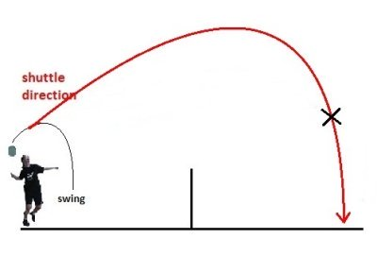
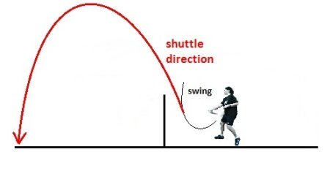
Basic Strokes 1. Defensive Badminton Clear/Lob
Overhead Defensive Clear
Underarm Defensive Clear

Slide 3
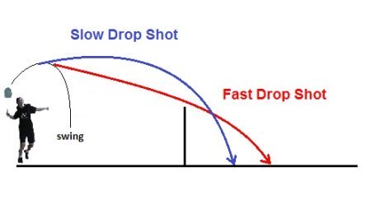
2. Badminton Drop Shot

Slide 4
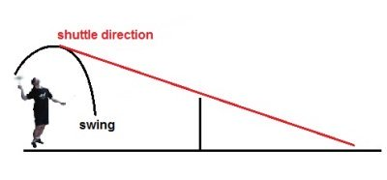
3. Badminton Smash

Slide 5
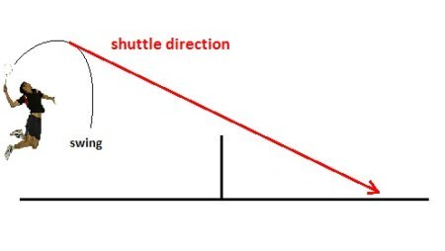
4. Badminton Jump Smash

Slide 6
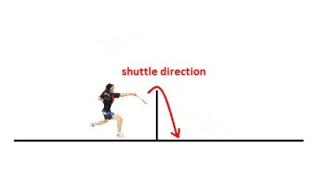
5. Badminton Net Shot (Tumbling/Spinning Net Shot)

Slide 7
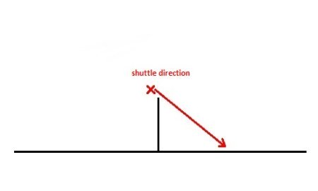
6. Badminton Net Kill

Slide 8
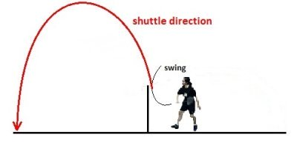
7. Defensive Badminton Net Lift

Slide 9
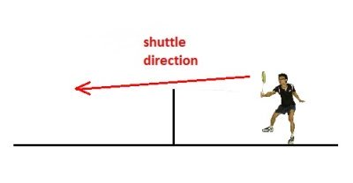
8. Badminton Drive

